Slide 1
Data Processing System (DPS)

Slide 2
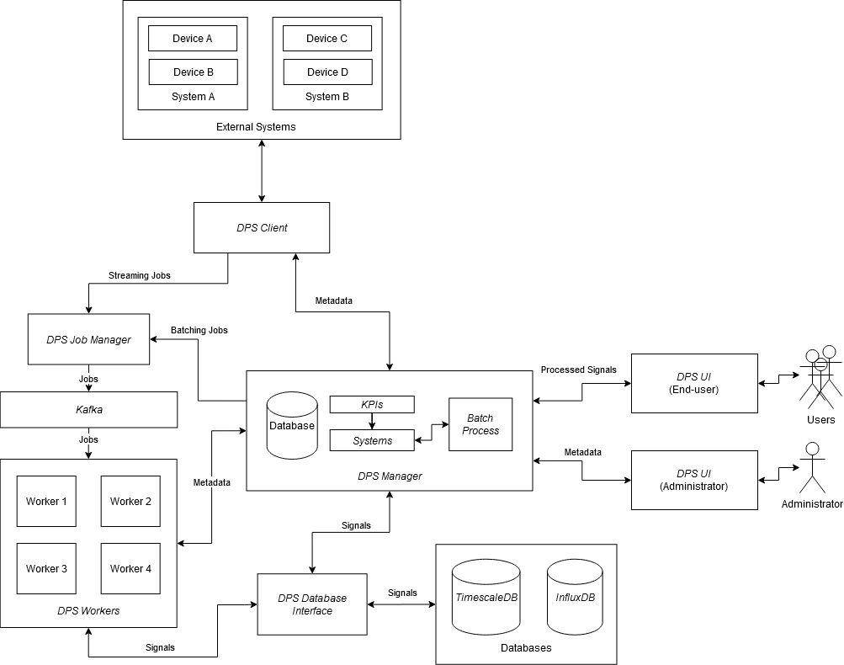
DPS
Microservice architecture
Database agnostic
Modular

Slide 3
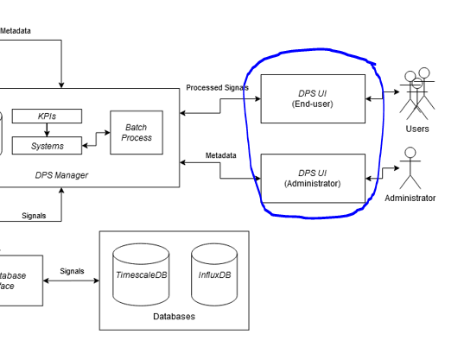
DPS UI
Interface to management server
Administrators configure the system
End-users run batch processes

Slide 4
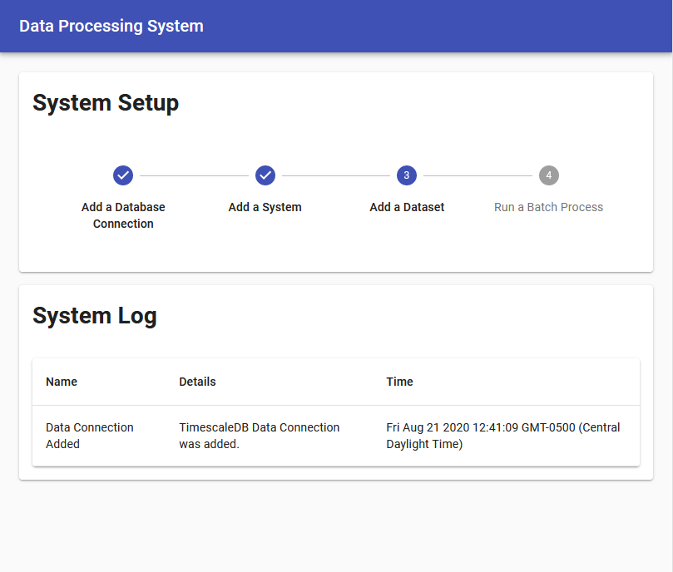
DPS UI (Admin) – Home Page

Slide 5
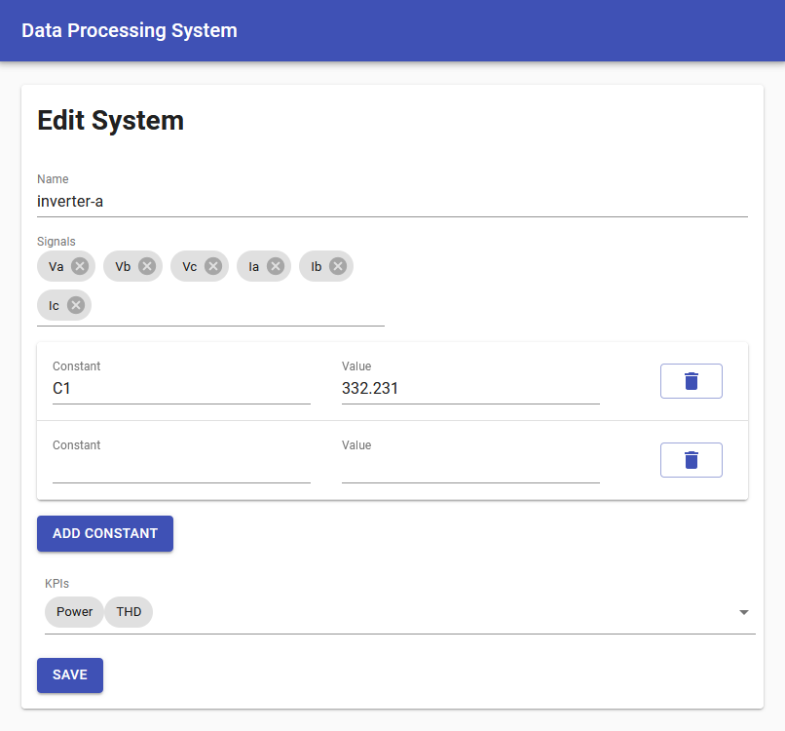
DPS UI (Admin) – Systems Page

Slide 6
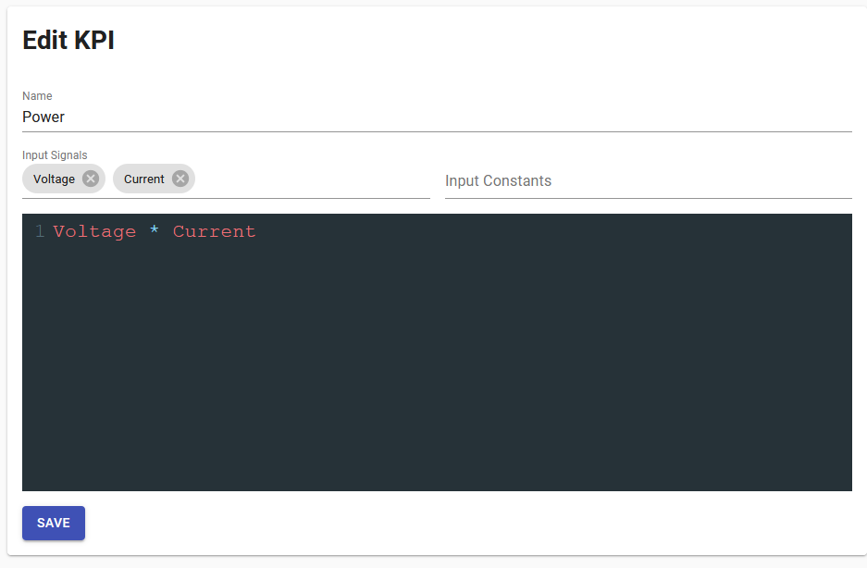
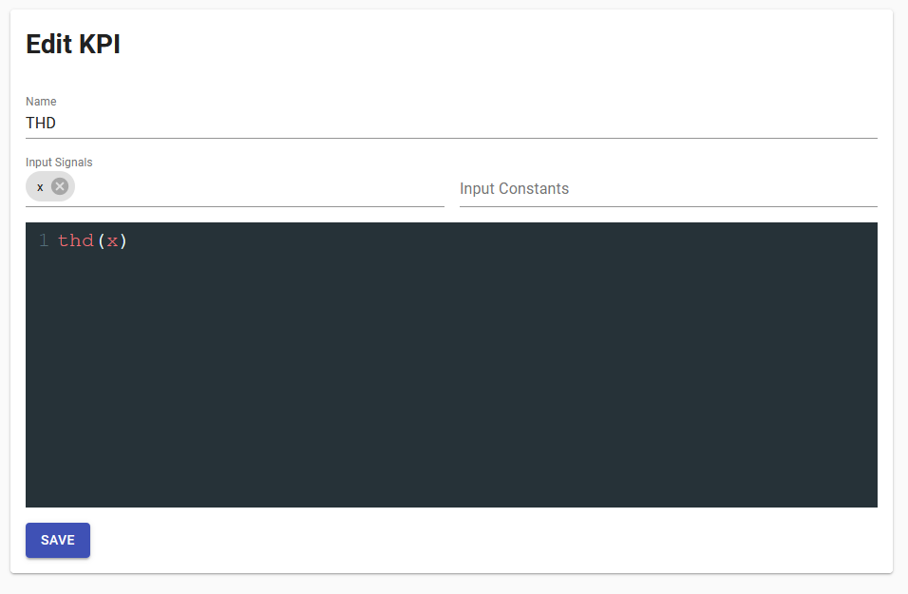
DPS UI (Admin) – Processors Page

Slide 7
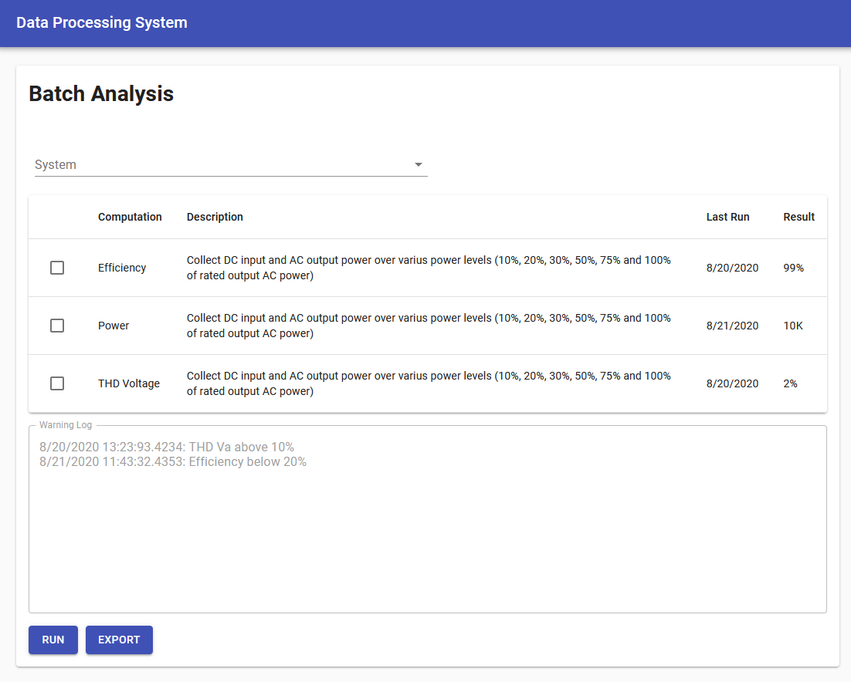
DPS UI (End-User) – Batch Process Page

Slide 8
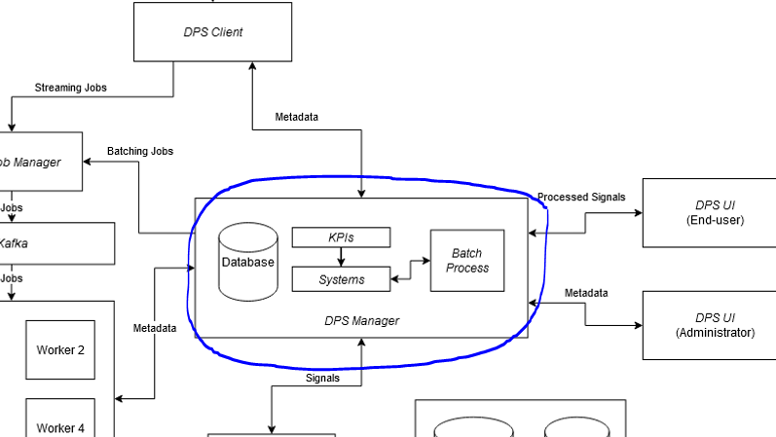
DPS Manager
REST API for system configuration
Interface between DPS Workers and DPS UI

Slide 9
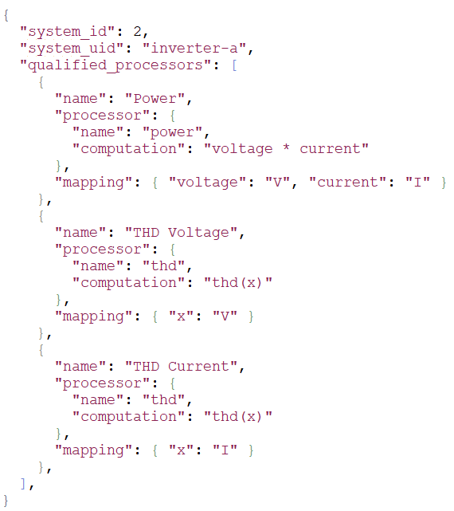
DPS Manager – REST API
HTTP GET /api/v1/system/2
Request
Response

Slide 10
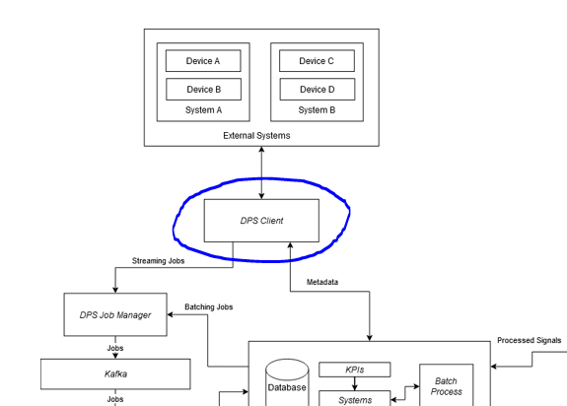
DPS Client
Python API for sending signal data
One client for Typhoon, LabVIEW, and real devices

Slide 11
DPS Client - Connecting

Slide 12
DPS Client – Sending a Sample

Slide 13
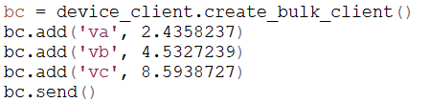
DPS Client – Sending Many Samples

Slide 14
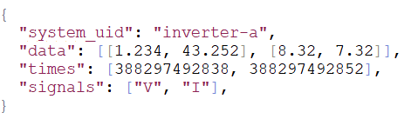
DPS Client – Example Request

Slide 15
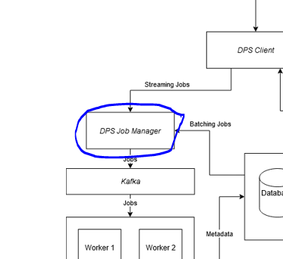
DPS Job Manager
Turns signal data into distributed jobs
Each computation (KPI) is converted to a job

Slide 16
DPS Job Manager – Producing Jobs (Input)
DPS Client Request
DPS Manager Metadata

Slide 17
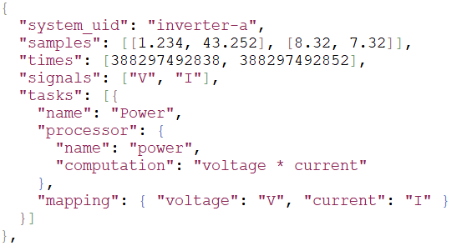
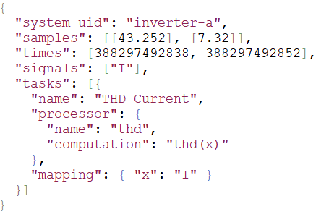
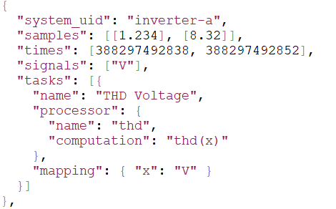
DPS Job Manager – Producing Jobs (Output)
Power Job
THD Current Job
THD Voltage Job

Slide 18
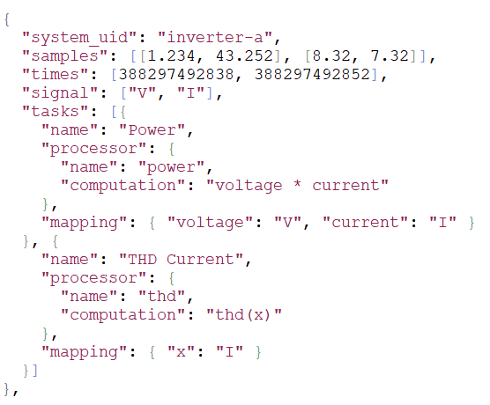
DPS Job Manager – Producing Jobs (Output)
Power and THD Current Job

Slide 19
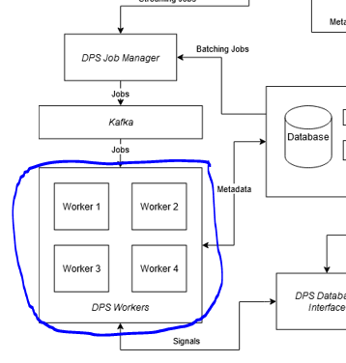
DPS Workers
A cluster which processes jobs produced by DPS Job Manager.
Kafka used to buffer jobs and synchronize nodes.

Slide 20
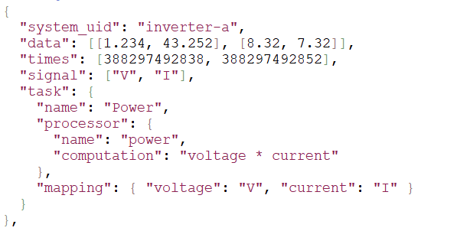
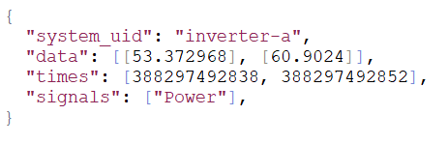
DPS Workers – Processing a Job
Power Job
Output

Slide 21
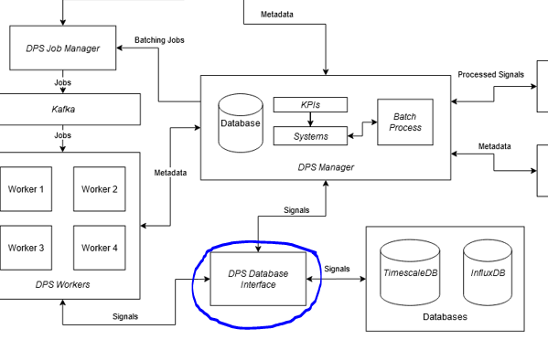
DPS Database Manager
Generic database microservice
DPS includes default implementation
Defines a protocol for 3rd party implementations

Slide 22
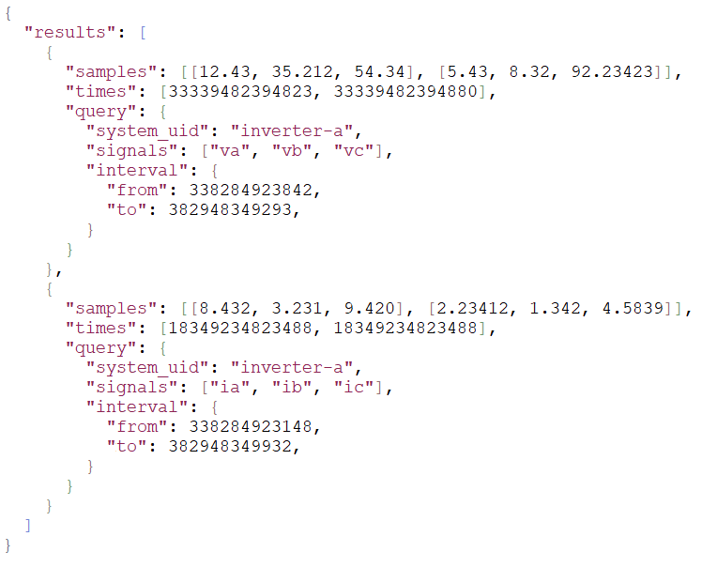
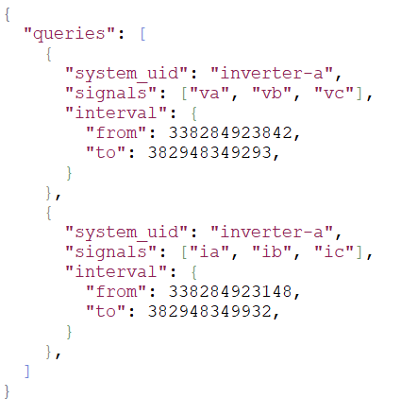
DPS Database Manager – Querying Signals
Request
Response

Slide 23
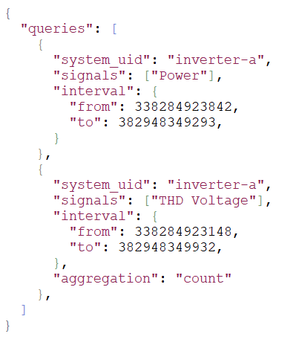
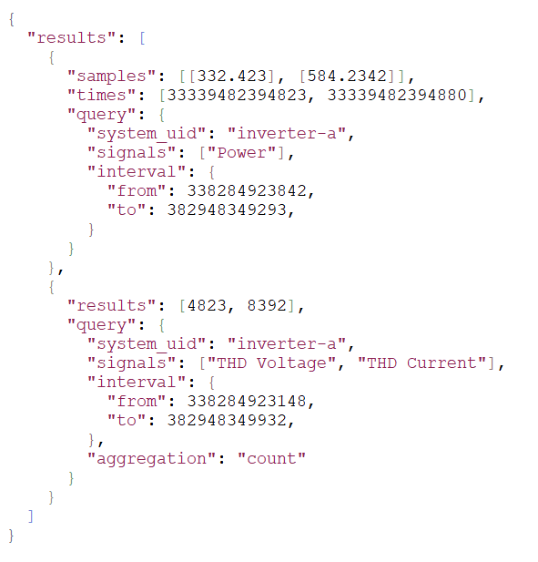
DPS Database Manager – Querying Signals
Request
Response

Slide 24
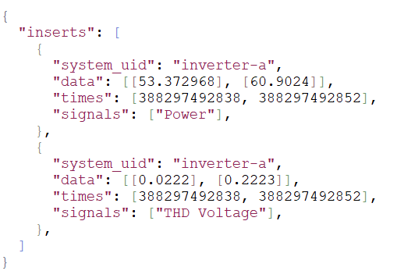
DPS Database Manager – Insert Request
HTTP 201
Response
Request

Slide 25
DPS Database Manager - Why
Supports arbitrary database models
Multi-database
Multi-schema
Provides default implementation
No setup required using defaults
Offloads MapReduce style computation to databases
Aggregations: count, average

Slide 26
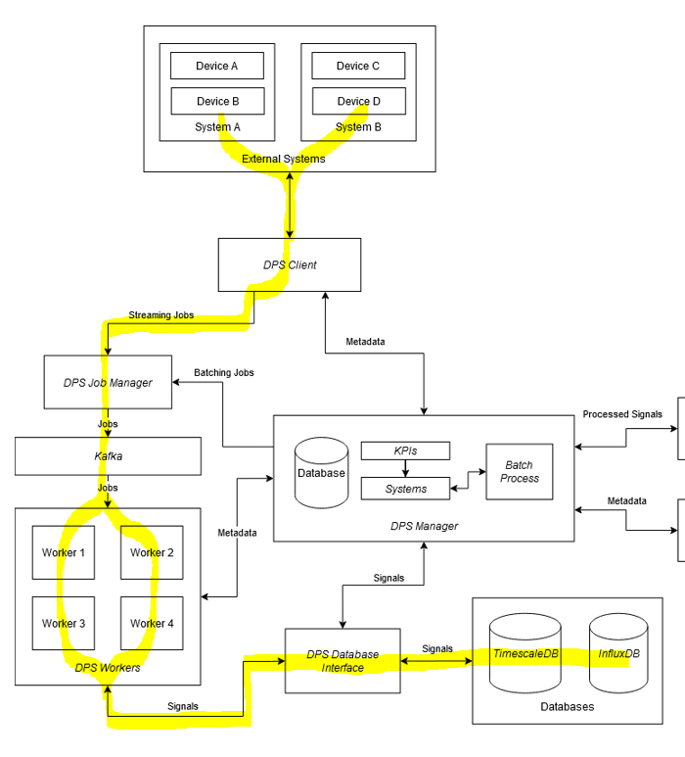
System Overview – Data Ingestion
Signal data travels this path:
Devices
DPS Client
DPS Job Manager
DPS Workers
DPS Database Manager
Database

Slide 27
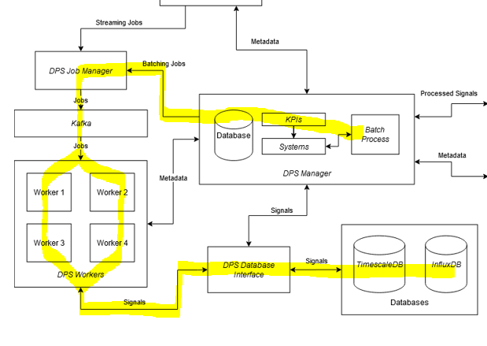
System Overview – Batch Processes
Batch processes travel this path:
DPS UI - Batch Process Page
DPS Job Manager
DPS Workers
DPS Database Manager
Database

Slide 28
System Overview – Batch Process
Query
(DPS Database Manager Request)
Results
(DPS Database Manager Response)
Jobs
(DPS Job Manager)

Slide 29
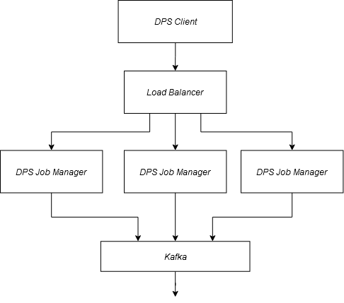
Extras - Load Balancing DPS Job Managers

Slide 30
Questions

